Slide 1


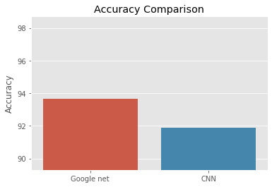
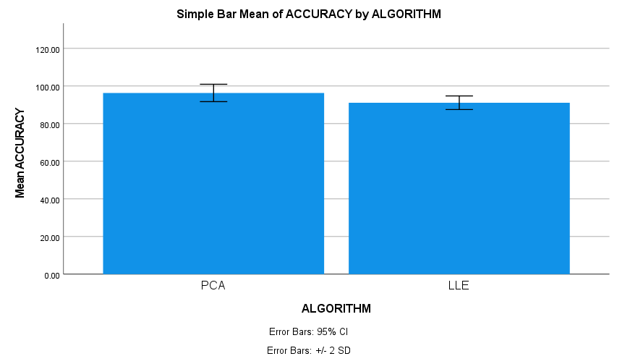
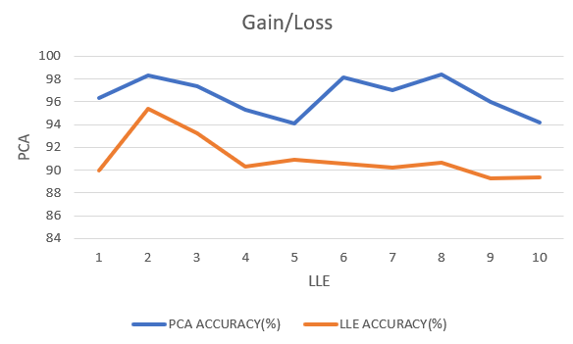
Name: Revanth Alli Register Number: 192110492
Guided by: Dr. T. P. Anithaashri
Ms. Poorani.S
Guided by Dr. Mary Valantina. G
Enhancing the Indian National Satellite System (INSAT) Style Clouds in Pic Pulse Using Principal Component Analysis Algorithm over Locally Linear Embedding Algorithm.
INTRODUCTION
Our study focuses on enhancing the representation of clouds captured in the style of the Indian National Satellite System (INSAT) within the Pic Pulse platform.
Leveraging sophisticated algorithms like Principal Component Analysis (PCA) and Locally Linear Embedding (LLE), we aim to refine the depiction of INSAT-style clouds in Pic Pulse.
By employing PCA and LLE algorithms, we seek to optimize the analysis and interpretation of INSAT-style cloud data, enhancing its utility for meteorological and environmental applications.
PCA efficiently reduces data dimensions of clouds captures. LLE preserves the local structure within the cloud data.
INSAT-style cloud imagery sourced from the Indian National Satellite System serves as the primary dataset for algorithm training and evaluation within the Pic Pulse platform.
Satellite view of clouds photography
MATERIALS AND METHODS
PCA compared LLE
From the Kaggle website, the image has been extracted.
Jupyter Notebook for Python v3.11
Conversion of enormous images into tiny ones
Analyzing the Outcomes Using
SPSS v25 by IBM
Accuracy
96.30%
PCA compared LLE
Image preprocessing, training, and validation
RESULTS
Algorithm | N | Mean | std.deviation | Std.error mean
Accuracy Principal component analysis algorithm Locally linear embedding Algorithm | 10 10 | 96.3050 91.1130 | 2.30997 1.80570 | .73048 .57101
PCA and LLE
Statistical Analysis values
Gain/Loss of PCA and SCA
In this work, the suggested technique Principal Component Analysis (PCA) yields better accuracy (96.30%) than the Locally Linear Embedding algorithm (LLE) (91.11%).
The principal component analysis Algorithm and the locally linear embedding Algorithm have the values of the Mean accuracy, Standard Deviation, and Standard Error .
DISCUSSION AND CONCLUSION
The Principal Component Analysis algorithm fared better than the Locally Linear Embedding Algorithm, with a high accuracy of 96.30%, according to the study's results.
The significance value p=0.016 (p<0.05) of the independent sample t-test indicates a significant difference in the algorithms among the 450 total sample.
The Principal Component Analysis (PCA) approach outperforms the other machine learning technique by 96.30% in terms of accuracy.
This study suggests that the Principal Component Analysis (PCA) technique is a more accurate method for analyzing cloud image dimension reduction than the Locally Linear Embedding (LLE) approach.
Similar findings have been noted in enhancing Indian National Satellite System (INSAT)-style cloud photos, where the integration of Principal Component Analysis (PCA) and Locally Linear Embedding (LLE) techniques has proven effective .
BIBLIOGRAPHY
Guleria, Abhishek, and Rakesh Kumar Bajaj. n.d. Technique for Reducing Dimensionality of Data in Decision-Making Utilizing Neutrosophic Soft Matrices. Infinite Study.
Lespinats, Sylvain, Benoit Colange, and Denys Dutykh. 2021. Nonlinear Dimensionality Reduction Techniques: A Data Structure Preservation Approach. Springer Nature.
Talia, Domenico, Paolo Trunfio, and Fabrizio Marozzo. 2015. Data Analysis in the Cloud: Models, Techniques and Applications. Elsevier.
Tempelman, Joshua R., Alexander F. Vakakis, and Kathryn H. Matlack. 2023. “Spectral Energy Scattering and Targeted Energy Transfer in Phononic Lattices with Local Vibroimpact Nonlinearities.” Physical Review. E 108 (4-1): 044214.
Padron-Manrique, Cristian, Aarón Vázquez-Jiménez, Diego Armando Esquivel-Hernandez, Yoscelina Estrella Martinez Lopez, Daniel Neri-Rosario, Jean Paul Sánchez-Castaneda, David Giron-Villalobos, and Osbaldo Resendis-Antonio. 2023. “Mb-PHENIX: Diffusion and Supervised Uniform Manifold Approximation for Denoizing Microbiota Data.”

